Slide 1
Managing HIV in Pregnancy
Dr Ab Rahim Abd Ghani
Head of Department and O&G Consultant
Hospital Pakar Sultanah Fatimah Muar
MBBS (Adelaide), M Med O&G USM
28/03/23

Slide 2
INTRODUCTION
The vertical transmission of HIV and syphilis can be effectively controlled through early diagnosis and treatment.
Yet globally there are still an estimated 150 000 cases of new paediatrics HIV infections each year.
WHO has outlined targets to eliminate mother-to-child transmission of HIV and syphilis infection (EMTCT HIV and syphilis) to achieve 0 new HIV infections among infants by 2020.

Slide 3
Malaysia has met all EMTCT criteria.
Significant reduction of new paediatrics HIV cases from 11.7 to 0.39 per 100 000 livebirths. (2011-2015).
Rate of vertical transmission of HIV from mother to child was reduced to below 2% in 2016.
Only 10 cases of pediatrics HIV cases in 2021 vs 86 cases in year 2000.
First country in WHO Western Pacific Region and 12th worldwide - officially presented with validation certificate for EMTCT of HIV and syphilis in October 2018.

Slide 4
IMPLEMENTATION STRATEGY FOR PTMCT PROGRAM OF HIV AND SYPHILIS
Early detection through HIV screening
Early detection of HIV infection in exposed infants
Full coverage of treatment to mother and child
Health education and counseling regarding HIV to pregnant woman and her partner
Continuous capability development of healthcare worker about mother-to-child HIV transmission at all levels.

Slide 5
ANTENATAL HIV SCREENING
Health education and counseling:
Accurate information regarding HIV transmission, purpose and benefit of screening and implication of infection to mother and child.
To ensure treatment adherence if the parturient is diagnosed with HIV positive and thus reduce the incidence of defaulters.
Consent of HIV testing should be written or verbal (informed consent) and documented in the record.
Mothers has the right to “opt out” however individual counseling should be offered to establish their knowledge and perception.

Slide 6
TIMING OF SCREENING
As early as possible in every pregnancy – to ensure informed and timely management.
A repeat HIV test is necessary in high risk patients who were first screened negative.
Some women seroconvert during pregnancy after first antenatal check-up.
Repeat test should be done preferably after 12 weeks of first test OR before 36 weeks of gestation.

Slide 7
1st visit/ first trimester

Slide 8
Screening during labour

Slide 9
Management of hiv pregnant women
1. COUNSELING
Importance of ART adherence and compliance to follow up.
Aim to achieve viral suppression level.
Requirement of delivery at hospital with specialist.
Formulate delivery plan.
Feeding and prophylactic treatment of exposed infants.
Confidentiality must be respected and ensured.
Health care providers are legally bound to notify the local health authority. (Infectious Disease Act 342 (1988))

Slide 10
Management of hiv pregnant women
2. REFERRAL
Multidisciplinary team in combine clinic (FMS, Obstetrician, ID physician/ Physician) and community healthcare personnel.
Inform the need for delivery in specialist hospital.
Early referral to paediatrician in anticipating a delivery.
If unexpected delivery occurred in centers without specialist, mother and newborn should be referred immediately to the respective specialist hospital for further management.

Slide 11
Management of hiv pregnant women
3. MEDICAL TREATMENT AND MONITORING
ART is the recommended method for prevention of maternal-to-child transmission (PMTCT).
Must be started in all pregnant mothers who are HIV+ regardless of CD4 count.
Ideally started at 14w of pregnancy.
Women who present after the 28 weeks must commence ART without delay – consult ID physician choice of ART regimen (Raltegravir/Dolutegravir achieve more rapid viral suppression and further reduce risk of perinatal transmission)
VL must be done between 32-36 weeks.

Slide 12
i)Pregnant women who are art naive

Slide 13
ii)Women who are stable on art before pregnancy
Existing ART is to be continued throughout pregnancy and after delivery.
Determine current CD4 and VL during early stage of pregnancy.
Refer ID physician if patient experiencing virological failure (drug resistant)

Slide 14
Choice of ART for pmtct
2 NRTI + (NNRTI Or Boosted Protease inhibitor Or Intergrase strand transfer inhibitor)
Preferred treatment : Tenofovir(TDF) + Emtricitabine(FTC) + Efavirenz (EFV)
Other regimes are also acceptable depending on the ID Physician
In women starting on ART after 28 weeks,consider Raltegravir based ART as drugs crosses the placenta rapidly.

Slide 15
Additional antenatal consideration
Check CD4 count in early pregnancy and at delivery
Check viral load as baseline, 2/52 after starting treatment, 24/52, 32 to 36/52 and at delivery
Delay invasive antenatal procedure until viral load is < 50 copies/ml. Non invasive prenatal testing should be offered.
If urgent invasive procedure warranted Initiate ART which include Raltergravir and single dose Nevirapine 2 to 4 hrs prior to procedure
Perform serial growth scans from 26-28/52 onwards
Watch out for complications of HIV/AIDS ed Kaposi sarcoma, Herpes simplex

Slide 16
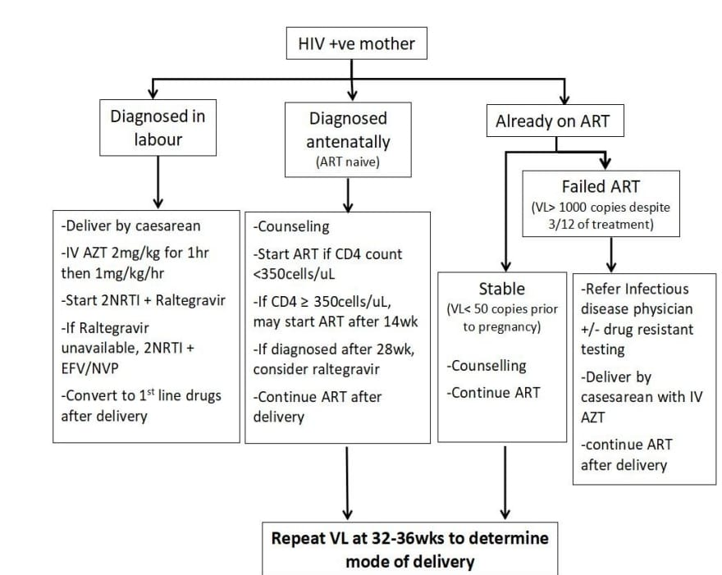
Management of HIV positive Mother
AZT- Zidovudine
NRTI-Nucleoside transcriptase inhibitor
EFV-Efavirenz
NVP-Nevarapine

Slide 17
4.Mode of delivery and intrapartum consideration
ECV is not contraindicated provided viral load <50 copies/ml
Delivery in specialist hospital with Obstetrician and paediatrician
Viral load at 32-36 weeks :
<50 copies – Vaginal delivery
50-399 copies – consider planned C section
>/ 400 copies/ unknown viral load- Planned C section recommended.
Intrapartum management should not differ from HIV negative women, forcep is preferred if instrumental delivery indicated.
Delayed cord clamping is not contraindicated.

Slide 18
4. MODE OF DELIVERY (cont’d)
Paediatrician should be alerted prior to delivery.
Post delivery, mothers should be referred to physician.
Counsel patient and partner that placenta will not be returned. It will be disposed following standard universal precaution.

Slide 19
5. INTRAPARTUM IV ZIDOVUDINE INFUSION
Recommended for women with a VL of >1000 copies/mL who present in labour or with ruptured membranes or admitted for planned PLCS regardless mode of delivery
2 mg/kg for the 1st hour followed by 1 mg/kg/h
Allow at least 3 hrs of infusion prior to elective C section as the cord blood to maternal Zidovudine levels are higher than those who received less than 3 hrs of infusion.
Continue oral ART but omit AZT during AZT infusion.
Stop infusion in the event of an emergency C section despite AZT still not completed 3 hrs.

Slide 20
Intrapartum consideration in women presenting with rupture membrane

Slide 21
Post partum care
Refer To ID or Physician regarding the continuation of ART for life unless the women is not motivated to be compliant and CD4count is >350 cell/ul
Cessation of ART should be monitored by ID team to minimise the risk of drug resistance.
Baby should be referred to paediatric team for post exposure prophylaxis and further management.

Slide 22
PosTNATAL CARE
1. BREASTFEEDING
The risk of vertical transmission is significantly higher (14-16%) with breastfeeding despite receiving ART.
HIV+ mothers are encouraged to avoid breastfeeding.
Strategies should be made to ensure babies of HIV mothers are formula fed and their care givers educated on proper hygiene.
Suppression of lactation should be considered for these patients.
Government provides free infant formula in government hospitals and health clinics for HIV-exposed infants up to 24 months of age, regardless of nationality.

Slide 23
PosTNATAL CARE
If the women insists on breastfeeding despite counseling; these criteria should be fulfilled.
Both mother and child need to be referred to paediatrician before breastfeeding is allowed.
Mother has no sign of infection/ wound over the breasts.
Maternal viral load should always be maintained below 50 copies/mL.
Infant’s HIV PCR test should be monitored every month until the child stopped breastfeeding.
Exclusive breastfeeding. Mixed feeding carries a higher risk of mother-to-child transmission.

Slide 24
POSTNATAL CARE
2. TREATMENT ADHERENCE AND CONTRACEPTION
Ensure mother and infant compliant to ART on every TCA.
Women should be referred early for preconception care.
Women and their partner should be educated on effective contraception to prevent transmission of HIV.

Slide 25
Postnatal care
Generally most forms of contraception can be use in women on ART.
Condom is the only contraceptive method proven to prevent both pregnancy and sexual transmission of HIV. Educate couple on correct condom use.
OCP – increase genital shedding of HIV-1, drug interaction with ART. May require higher dose of estrogen.
If an intra uterine device or hormonal contraception is to be considered, they must be used together with the condom.
BTL can be considered if there is obstetrics/ medical indication. Decision of BTL need to be discussed with ID Physician and Obstetrician and consent is required from husband and wife.
Yearly cervical smear is advised.

Slide 26
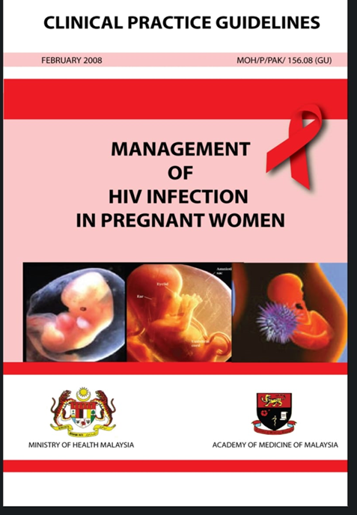

Slide 27
SEKIAN TERIMA KASIH

