Slide 1
Management of Syphilis in Pregnancy
Dr Latha R Selvarajah
MBBS(UM), MRCP(Ire), AdvMDerm(UKM), AM(Mal)
HOD & Consultant Dermatologist
Hospital Sultan Ismail

Slide 2
Case 1
26 years old, G2P1 at 18 weeks POA
H/O STD 5 years ago and claim given 3 injections at that time
Current results:
RPR 1:4
TPPA positive

Slide 3
Case 1
How should she be managed?
Repeat serology at 28 weeks / delivery
She is re-infected, treat her with penicillin now
Reassurance with no further workup
None of the above
I don’t know – refer FMS / Dermatologist

Slide 4
Case 2
22 year old, primigravida at 10 weeks POA
RPR 1:2 and TPPA negative
No H/O STD
Husband newly diagnosed HIV and syphilis

Slide 5
Case 2
How should she be managed?
No action, pregnancy can cause false positive
Repeat serology at 28 weeks / delivery
Repeat serology at 4 to 6 weeks
Reassurance, no further workup
I don’t know, I will refer

Slide 6
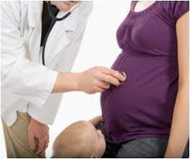
Case 3
21 year old lady, G4P3 at 14 weeks POA
RPR non reactive, TPPA positive
No H/O receiving treatment for STD in the past
Physical examination normal

Slide 7
Case 3
How would you manage?
Repeat serology at 28 weeks / delivery
Repeat serology at 4 to 6 weeks
Reassurance, no further workup
Treat her with penicillin

Slide 8
Case 4
18 year old lady, G1P0 at 14 weeks POA
RPR 1:128, TPPA positive
Husband similar results
Both were treated as early syphilis with IM Benzathine Penicillin
Repeated serology 1 month later was 1:256

Slide 9
Case 4
How would you manage?
Re-treat her with penicillin
Repeat serology at 4 weeks
Ask further history – re-exposure and check for concurrent HIV infection
I don’t know, I will refer

Slide 10
My talk will answer the following…
When should syphilis be suspected in a pregnant lady?
When should syphilis be tested in a pregnant lady?
Why should syphilis be tested in a pregnant lady?
How should syphilis serology be interpreted?
How do you monitor after treatment?

Slide 11
When should syphilis be suspected in a pregnant lady?
Sexual / direct contact (infected lesions) with a person who has syphilis
If the cause is not known for a hydropic or stillbirth newborn -> do postpartum screening
REMEMBER: ALL pregnant women must be assumed to be at risk!

Slide 12
When should syphilis be tested in a pregnant lady?
All pregnant lady should be screened serologically for syphilis
When to screen?
At first prenatal visit
High risk:
At 28 - 32 weeks POA
At delivery
Fetal death at > 20 weeks gestation

Slide 13
High risk mother
RPR reactive on booking
Single mother
Female sex worker
HIV positive mother
Rape case
History of STI
Multiple sex partners
History of stillbirth / miscarriage
Unbooked / unscreened pregnancy
Alcohol / drug abuse

Slide 14
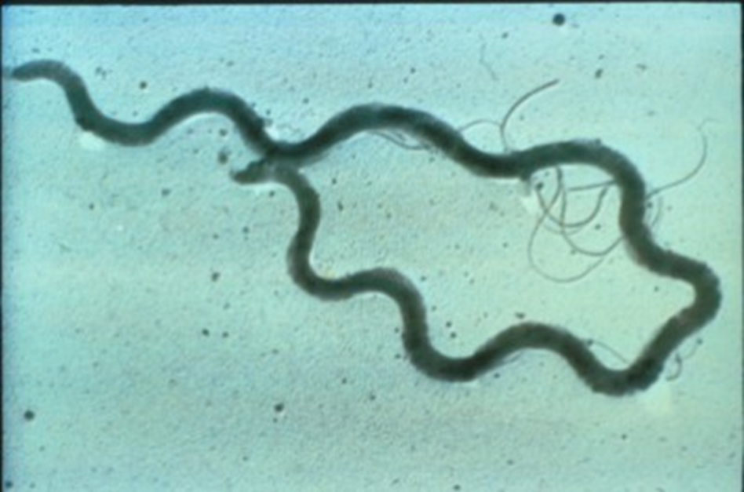
Introduction
Causative organism: Treponema pallidum
Spirochete
Obligate human parasite
Transmission
Sexual
Trans-placental
Percutaneous following contact with infectious lesions
Blood Transfusion

Slide 15
Syphilis – The “Great Imitator”
Incubation Period – 21 days (median)
3 clinical stages of syphilis
Primary:
Painless ulcer (chancre) at inoculation site
Secondary:
Rash, Fever, Lymphadenopathy, Malaise
Tertiary:
Gumma, cardiovascular syphilis
Latent:
Asymptomatic
Neurosyphilis:
Can occur at any stage

Slide 16
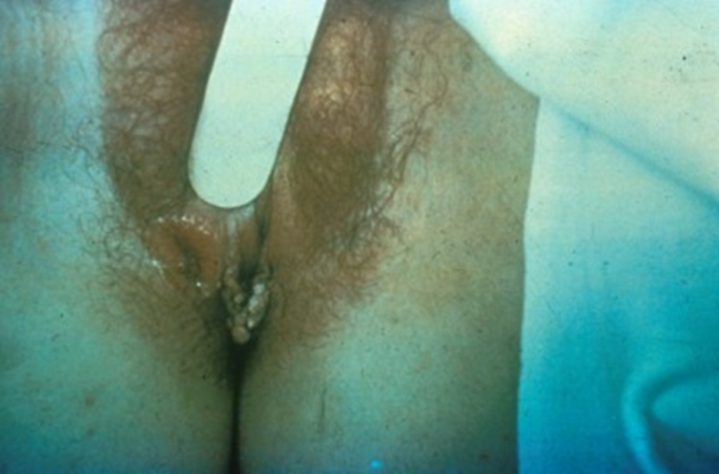
Primary Syphilis
Incubation period: 9-90 days
Chancre
painless, indurated with clean base
Highly infectious
Typically heals within 3-6 weeks
Multiple lesions can occur
Regional lymphadenopathy: bilateral, painless
Serologic tests for syphilis may not be positive during early primary syphilis.

Slide 17
Secondary Syphilis
Incubation period: 6 weeks to 6 months
Clinical features:
Rash (75%–100%)
Lymphadenopathy (50%–86%)
Malaise
Mucous patches (6%–30%)
Condylomata lata (10%–20%)
Alopecia (5%)
Serologic tests are usually highest in titer
Can also be false negative (Prozone effect)

Slide 18
Tertiary Syphilis
Develop in untreated patient within 1 to 30 years
Clinical features:
Gummatous lesions
Cardiovascular syphilis
Non infectious

Slide 19
Neurosyphilis
May occur at any stage of syphilis
Can be asymptomatic
Early neurosyphilis occurs a few months to a few years after infection
Clinical manifestations can include acute syphilitic meningitis, meningovascular syphilis, and ocular and auditory involvement
Neurologic involvement can occur decades after infection and is rarely seen
Clinical manifestations can include general paresis, tabes dorsalis, and ocular involvement
Ocular involvement can occur in early or late neurosyphilis.

Slide 20
Latent Syphilis
Host suppresses infection, thus no lesions are clinically apparent
Only evidence is a positive serologic test
May occur between primary and secondary stages, between secondary relapses, and after secondary stage
Categories:
Early latent: <1 year duration
Late latent: ≥1 year duration

Slide 21
Latent Syphilis
Criteria for early latent syphilis: The following noted within the year preceding the evaluation
Documented seroconversion or 4-fold increase in comparison with a serologic titer
Symptoms of primary or secondary syphilis reported by patient
Contact to an infectious case of syphilis
Only possible exposure occurred within past 12 months
Patients with latent syphilis of unknown duration should be managed clinically as if they have late latent syphilis.

Slide 22
Diagnosis
History
Physical examination
Serology
Mainstay for syphilis testing
Two classes of serologic tests
Non-treponemal
Treponemal
The use of only one type of serologic test is insufficient for diagnosis

Slide 23
Nontreponemal Serologic Tests
Principles
Measure antibody directed against a cardiolipin-lecithin-cholesterol antigen
Not specific for T. pallidum
Titers usually correlate with disease activity and results are reported quantitatively
May be reactive for life, referred to as “serofast”
Nontreponemal tests include VDRL, RPR, TRUST, USR

Slide 24
Treponemal Serologic Tests
Principles
Measure antibody directed against T. pallidum antigens
Qualitative
Usually reactive for life
Titers should not be used to assess treatment response
Treponemal tests include TP-PA, FTA-ABS, EIA, and CIA
Cannot differentiate between current and past infection.

Slide 25
Algorithm for Screening

Slide 26
Interpretation of Serological Tests

Slide 27
False Positive Tests
Viral infections (Infectious mononucleosis)
Bacterial infections (pneumonia, TB)
Connective tissue disease (rheumatoid arthritis, SLE)
Elderly
Pregnancy

Slide 28
Interpretation of Serological Tests
Initial screening may be negative in early primary syphilis.
If the history is strongly suggestive of syphilis then an RPR should be repeated in 3-4 weeks
Most people become negative for RPR with adequate treatment.
some may maintain a low titer RPR (<1:8) for life despite adequate treatment. This is the serofast state.
A negative RPR test with a positive TPPA:
can be treated or untreated syphilis.
if there is no documentation of treatment for syphilis, the patient must be treated.
Prozone phenomenon
false negative response resulting from overwhelming antibody titers
associated with HIV, pregnancy and secondary syphilis

Slide 29
Treatment
Recommended Regimen for Syphilis During Pregnancy
Penicillin G is the only known effective antimicrobial for treating fetal infection and preventing congenital syphilis. Pregnant women should be treated with the recommended penicillin regimen for their stage of infection.
Patients who are skin-test-reactive to penicillin should be desensitized in the hospital and treated with penicillin.
Source: Centers for Disease Control and Prevention. Sexually transmitted infections treatment guidelines 2021.

Slide 30
Treatment
Primary, secondary and early latent syphilis
Benzathine penicillin G 2.4 million units intramuscularly in a single dose
Some evidence suggests that additional therapy can be beneficial
a second dose of benzathine penicillin 2.4 million units IM can be administered 1 week after the initial dose
Late latent syphilis
Benzathine penicillin G administered as 3 doses of 2.4 million units intramuscularly each at 1-week intervals
Source: Centers for Disease Control and Prevention. Sexually transmitted infections treatment guidelines 2021.

Slide 31
Issues related to treatment
Penicillin allergy: < 1%.....verify and desensitize
Jarisch-Herxheimer reaction
In pregnant women, missed doses are NOT ACCEPTABLE -> full course of therapy must be repeated if scheduled dose is delayed by >9 days
All women who have syphilis should be offered testing for HIV infection
Refer to specialist hospital for delivery
Notify positive case!

Slide 32
Jarisch-Herxheimer Reaction
Self-limited reaction to antitreponemal therapy
Fever, malaise, nausea/vomiting; may be associated with chills and exacerbation of secondary rash
Occurs within 24 hours after therapy
Not an allergic reaction to penicillin
More frequent after treatment with penicillin and treatment of early syphilis
Antipyretics can be used to manage symptoms, but they have not been proven to prevent this reaction.
Pregnant women should be informed of this possible reaction, that it may precipitate early labor, and to call obstetrician if problems develop.

Slide 33
Monitoring after treatment
Preferably serological titers (RPR / VDRL) monthly until delivery
At minimum, serological test repeated at 28-32 weeks and at delivery
If diagnosed > 6/12 POA, refer for fetal assessment

Slide 34
Causes of treatment failure
High RPR titre at diagnosis / delivery
Delivery < 36 weeks
Short interval during treatment and delivery (< 30 days)
Re-infection
Non-penicillin treatment

Slide 35
Indications of treatment failure
Persistence / recurring signs and symptoms
Sustained fourfold increase in non-treponemal titer, OR failure of titer to reduce fourfold within 6 months
Measures:
Retreat: weekly IM injection of Benzathine penicillin G 2.4 million units for 3/52
Test for HIV co-infection
CSF examination
REFER DERMATOLOGY AND OBSTETRIC TEAMS!

Slide 36
Management of Sexual Partners
For sex partners of patients with syphilis in any stage
Do syphilis serology
Perform physical exam
For sex partners of patients with primary, secondary, or early latent syphilis
Treat presumptively as for early syphilis at the time of examination, unless
The nontreponemal test result is known and negative and
The last sexual contact with the patient is > 90 days prior to examination.

Slide 37
Postpartum management issues
Even with appropriate penicillin therapy, up to 10% of infants may have congenital syphilis
Serologic testing of maternal blood at time of delivery is superior to infant blood testing
Umbilical cord blood testing is not recommended
A comparison of maternal and infant non-treponemal test titers is very useful to guide therapy
Neonates should be examined for congenital syphilis.

Slide 38
Congenital syphilis
The risk of vertical transmission depends on the stage of maternal syphilis
Untreated primary or secondary syphilis: 70 to 100%
Early latent syphilis: 40%
The risk is extremely high for the first 4 years after acquisition of infection if not treated
Late latent syphilis: < 10%
Remember: 50% are born asymptomatic, manifestations can first be seen up to 2 years of age

Slide 39
Congenital syphilis (early < 2 years)

Slide 40
Congenital syphilis (late > 2 years)

Slide 41
Case 1
26 years old, G2P1 at 18 weeks POA
H/O STD 5 years ago and claim given 3 injections at that time
Current results:
RPR 1:4
TPPA positive

Slide 42
Case 1 answer
Seropositive pregnant women should be considered actively infected unless an adequate treatment history is clearly documented and sequential antibody titers have declined
Serofast low antibody titers might not require treatment
Persistent higher antibody titers might indicate re-infection and require re-treatment

Slide 43
Case 2
22 year old, primigravida at 10 weeks POA
RPR 1:2 and TPPA negative
No H/O STD
Husband newly diagnosed HIV and syphilis

Slide 44
Case 2 answer
False positive RPR is common in pregnancy
However, in high risk patients, serologic testing should be repeated twice in the 3rd trimester at 28 to 32 weeks and at delivery
Initial screening may be negative in early primary syphilis.
If the history is strongly suggestive of syphilis then an RPR should be repeated in 3-4 weeks

Slide 45
Case 3
21 year old lady, G4P3 at 14 weeks POA
RPR non reactive, TPPA positive
No H/O receiving treatment for STD in the past
Physical examination normal

Slide 46
Case 3 answer
Patient should be treated as late latent syphilis
There is some risk of vertical transmission

Slide 47
Case 4
18 year old lady, G1P0 at 14 weeks POA
RPR 1:128, TPPA positive
Husband similar results
Both were treated as early syphilis with IM Benzathine Penicillin
Repeated serology 1 month later was 1:256

Slide 48
Case 4 answer
Ask further history – re-exposure and check for concurrent HIV infection
If no re-exposure and HIV is negative, repeat RPR in 4 weeks time
Consider re-treatment if no fourfold decrease in titer

Slide 49
THANK YOU

