Slide 1
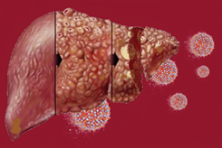
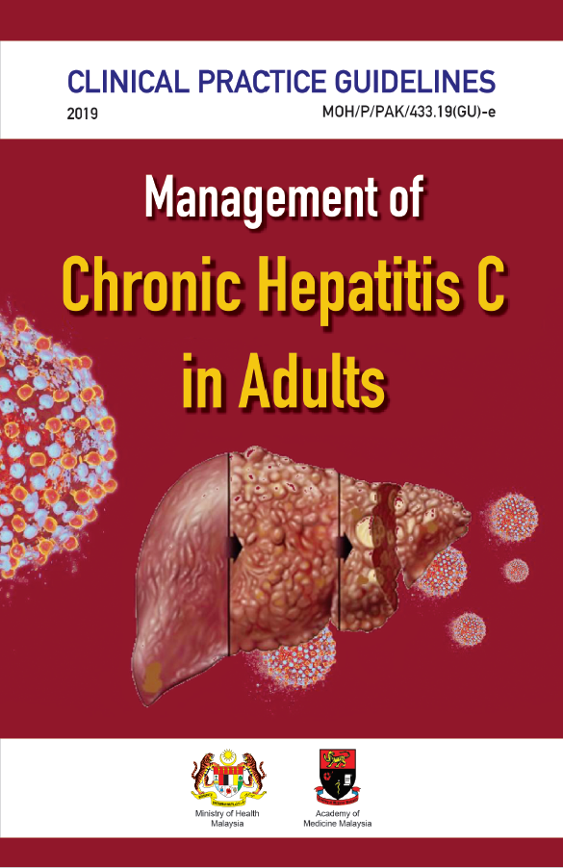
TRAINING OF CORE TRAINERS
CPG Management of Chronic Hepatitis C in Adults
SCREENING OF HEPATITIS C
Dr. Ruziaton Hasim
Family Medicine Specialist

Slide 2
Learning Objectives
To increase awareness on importance of HCV screening
To identify risk factors of HCV infection
To improve strategies of HCV screening

Slide 3
Background
Most chronic hepatitis C Virus (HCV) infected individuals are asymptomatic & thus unaware of their infection. Many remained undetected.
Failure to identify them prevents linkage to care & successful control of HCV.
Therefore, screening of HCV is an important step towards improving detection & ultimately treatment & cure of infected individuals.

Slide 4
HCV Infection - Natural History
Acute HCV
Chronic HCV
85% (85%)
Resolved
15% (15%)
Stable
80% (68%)
Cirrhosis
20% (17%)
Slowly
progressive
75% (13%)
HCC
Liver failure
25% (4%)
Time/yr
HCC
10
20
30
Source: Nancy Reau. ID Week 2015 HCC: Hepatocellular Carcinoma
Notes:
The next slide illustrates the natural history of HCV infection. A small percentage of individuals will go on to spontaneous resolution—about 15%—whereas 85% develop chronic disease. Of this 85% who develop chronic disease, about 80%, (68% of all infected individuals), will have stable chronic hepatitis without significant progression over the next 20 years. By contrast, 20% of those who develop chronic disease (17% of all infected individuals) will develop cirrhosis over the next 20-25 years. Of these cirrhotic patients, many will continue to progress slowly, and about 25% will rapidly develop hepatocellular carcinoma (HCC) or liver failure. Thus, liver cancer and liver failure occur in approximately 4% of patients who are exposed to HCV over a 20- to 25-year period.

Slide 5
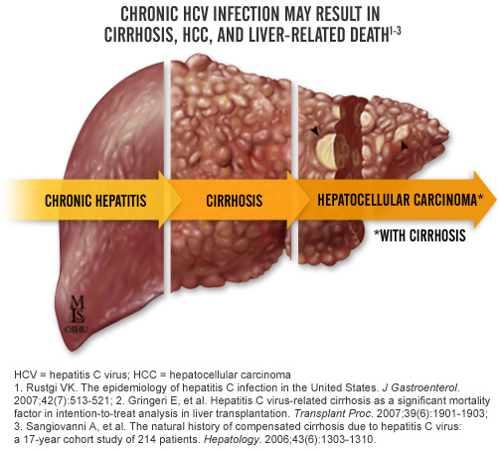
Timely Treatment Can Arrest The Disease Progression And Prevent Death
HCV Infection - Natural History-₂
50% F3 in 10 years
28% in 10 years
Notes:
1. Arrest disease progression
2. Prevent disease complications
3. Prevent complicated treatment regime and longer duration of treatment
4. Improve quality of life
5. Prevent death
5.

Slide 6
Large Burden of Undiagnosed & Untreated Individuals with HCV
Majority of individuals living with Hepatitis C are NOT AWARE that they are infected
Chronic
HCV
<15% of those infected with Hepatitis C are diagnosed
World population 6.7 billion
Source : Wei L et al. Gastroenterology 2014;146:1145–1150.
Notes:
Large burden of undiagnosed and untreated individuals with HCV, many are not aware
The issue is less than 15 % are diagnosed and treated

Slide 7
Gaps Along the HCV Care Continuum
For Malaysia, this is the largest gap i.e. up to 90-95% individuals living with HCV are UNAWARE that they are infected
Left side of the cascade equally/more important
DAAs only help once you get here
9%
Chronic HCV Infected
Diagnosed and Aware
Access to Care
HCV Confirmation
Liver Disease
assessment
Prescribed HCV Treatment
Achieved SVR
7
Notes:
Worse in Malaysia only about 10% is diagnosed.
i.e. up to 90-95% individuals living with HCV are UNAWARE that they are infected, in the end only 10% achieved SVR

Slide 8
A large number of HCV patients are UNDIAGNOSED
Most nations fail to identify a large proportion of patients with chronic HCV infection¹
As few as 15-25% of patients are diagnosed
? Asian patients detected - lesser still
HCV screening program
Survey of 4000 primary care physicians²
Only 59% of 1412 respondents asked patients about HCV risk factors
Primary care physicians play an important role in HCV screening & provide linkage of care
http://www.thewellingtonliverunit.com/treatments-hepatitis-c.asp; Schlosser et al. EASL 2009; Vermehren et al. DGVS 2010; Gane. New Zealand Doctor. 2007; http://www.hepatitiscmsg.org/hep-c-facts--stats.html.
1. Kim WR. Hepatology. 2002;36:S30-S34. 2. Shehab TM, et al. J Viral Hepat. 2001;8:377-383.
8

Slide 9
CPG Recommendation
9

Slide 10
WHO TO SCREEN?
Healthcare, emergency medical, and public safety workers after needle sticks, sharps, or mucosal exposures to HCV-infected blood
People who inject drugs (PWID)
PWID have the highest risk of infection. Globally, the prevalence of HCV is 67% among PWID. In Malaysia, 59% HCV infection acquired through injecting drugs.
Risk of HCV infection varies depending upon the frequency of medical procedures (i.e. number of injections/person/year) and level of infection control practices. High frequency of injections and low level of infection control can result in high prevalence of HCV in the general population.
Recipients of blood / blood products / clotting factor concentrates / organ transplant before July 1994
There is a high risk of HCV infection via transfusion of unscreened blood and blood products.
HEPATITIS
C
10

Slide 11
WHO TO SCREEN?-₂
Persons on long-term hemodialysis (ever)
Intranasal illicit drug use
Non-injecting drug use (e.g. through sharing of inhalation equipment for cocaine) is associated with a higher risk of HCV infection. The present of blood and HCV RNA in the nasal secretions of HCV-positive long-term drug sniffers can be transferred onto sniffing implements (i.e., straws) during simulated intranasal drug use.
Risk of HCV infection among dialysis patient is high in condition where level of infection-control practices is low / ignored. Risk of HCV infection also varies depending upon the frequency of medical procedures (i.e.no of injections/person/year). A study reported that 53.9% of patient on dialysis from 1985 and September 1991 were positive for anti-HCV.
HEPATITIS
C
11

Slide 12
WHO TO SCREEN?-₃
Persons who were ever incarcerated
Persons with HIV infection, in particular MSM, are at increased risk of HCV infection through unprotected sex
Persons who were incarcerated are at risk for Hepatitis C because many people in jails or prisons already have Hepatitis C
Persons with HIV infection, in particular MSM, are at increased risk of HCV infection through unprotected sex.
Unexplained chronic liver disease and/or chronic hepatitis including elevated ALT levels
Children born to HCV infected women
HCV transmission risk is estimated as 4 –8% among mothers without HIV infection. Transmission risk is estimated as 17-25% among mothers with HIV infection.
Approximately 60% to 70% of chronically (HCV) infected person will eventually develop chronic liver disease.
12

Slide 13
WHO TO SCREEN?-₄
People with sexual partners who are HCV infected
Solid organ donors (deceased and living)
There is low or no risk of sexual transmission of HCV among HIV-uninfected heterosexual couples and HIV-uninfected men who have sex with men (MSM). The risk of sexual transmission is strongly linked to pre-existing HIV infection.
There is a risk of HCV infection in unscreened organ donors.
Persons with percutaneous/parenteral exposures in an unregulated setting
Tattoo recipients have higher prevalence of HCV compared with persons without tattoos (odds ratio = 2.24, 95% CI 2.01, 2.50).
13

Slide 14
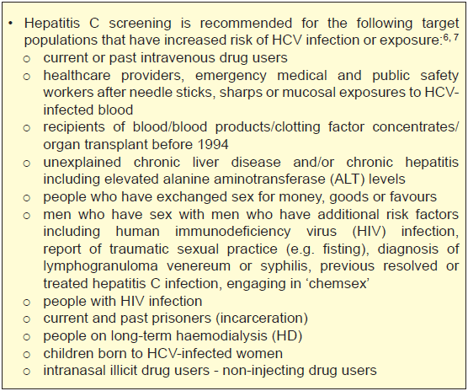
High Risk Groups
14

Slide 15
WHICH METHOD?
Antibody HCV Testing?
Antigen HCV Testing?
15
Notes:
Test screening must be reliable and accurate and in a timely manner

Slide 16
HCV Screening Strategies
Increase public awareness
Raise awareness among prisoners, drug rehab. inmates, drug use shelter residents & other high risk key population groups
Dialogues with relevant authorities governing guidelines to places that are potentially risky for hepatitis C transmission
Talks & Kem Kesihatan (health camps)
Easily accessible education materials for public
Guidelines at potentially risky HCV transmission places that provide services for:
bekam (cupping)
tattoo
acupuncture
shaving/hair removal with razors
manicure/pedicure & foot scraping
16

Slide 17
HCV Screening Strategies-₂
Targeted case finding:
High index of suspicious
Strategise e.g. 100% among methadone clients, RVD, STI & health care staff with risk factors
IVDU, blood donors prior 1994, needle stick injury (NSI), tattoos, body piercing
Interested public
Support & training of primary care practitioners/workers
Easily accessible HCV testing methods - rapid diagnostic tests (RDTs) in KK, immunoassay with reflex testing
17

Slide 18
Take Home Messages
Many HCV infected individuals are unaware of their status and thus undiagnosed.
Hepatitis C screening should be targeted for populations with increased risk of HCV infection or exposure.
Various strategies must be employed to improve HCV screening.
18

Slide 19
Thank you

