Slide 1
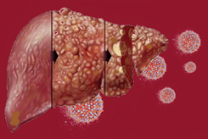
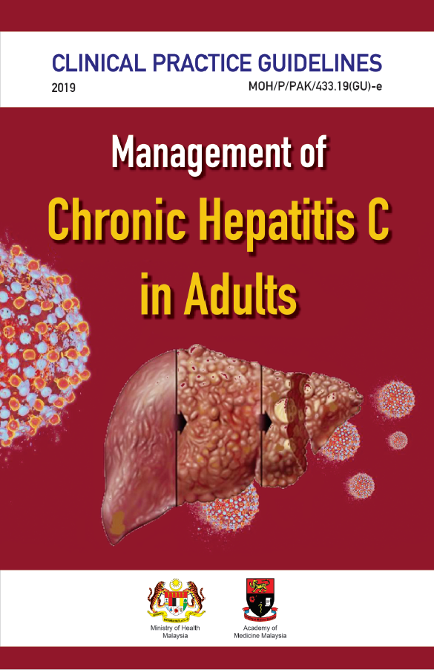
TRAINING OF CORE TRAINERS
CPG Management of Chronic Hepatitis C in Adults
IMAGING
Dr. Farah Naz Saleem
Radiologist

Slide 2
Learning Objective
To gain an understanding on different modalities in diagnosing liver cirrhosis

Slide 3
Gold Standard
Liver biopsy:
Gold standard to detect liver fibrosis and cirrhosis
Cons
Invasive
Discomfort
Associated morbidity and mortality

Slide 4
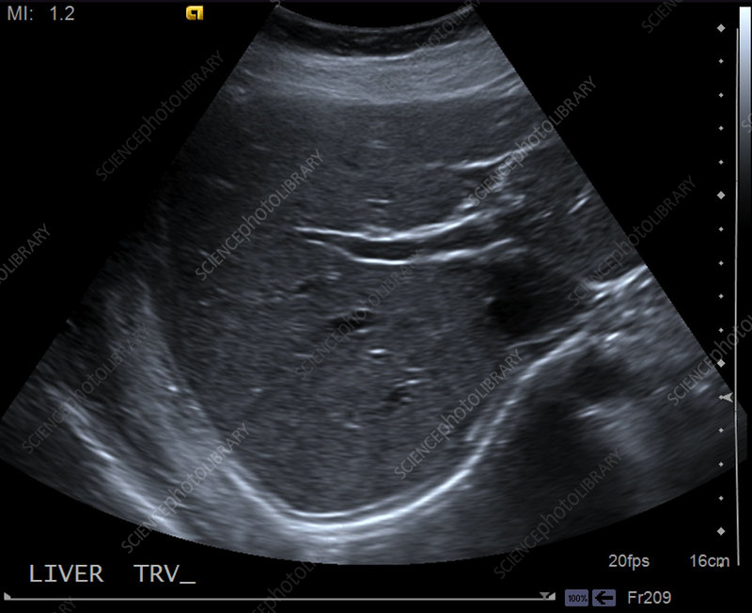
Ultrasound vs Liver biopsy
In two small diagnostic studies, the comparison of conventional ultrasonography (USG) to liver biopsy showed a PPV of 78 - 80%.²² ⁻ ²³
The sensitivity was moderate at 68.18%²³
Specificity was low at 14%.²³
Kelly EMM et al. Gastroenterol Hepatol (N Y). 2018;14(6):367-73.
Kamal MM et al. Ann Pak Inst Med Sci. 2009;5(4):237-41.

Slide 5
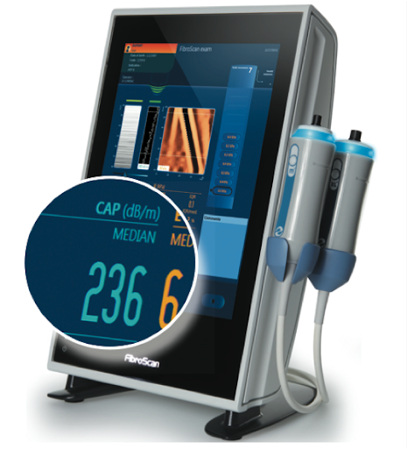
Transient Elastography (TE)
Commonly known as Fibroscan
TE has better sensitivity & specificity compared with USG or doppler USG.

Slide 6
Transient Elastography (TE) -₂
The AUC increases from stage F1 to F4 liver fibrosis for both TE and US. However, the results are higher in TE.²⁴
The diagnostic accuracy is much better in TE compared with doppler USG in F2 to F4 liver fibrosis.
The AUC for TE in F2, F3 and F4 is 0.89, 0.96 and 1.0 respectively.²⁵
24. Wang JH et al. J Gastroenterol. 2009;44(5):439-46.
25. Moustafa EF et al. Arab J Gastroenterol. 2017;18(1):6-12.

Slide 7
TE vs Magnetic Resonance Elastography (MRE)
In a diagnostic study, TE & magnetic resonance elastography (MRE) had comparable accuracy in detecting all stages of liver fibrosis.
However, the TE examiners were not blinded on the clinical data of the patients.²⁶
MRE is not available in Malaysia as of now.
However, once MRE is available, it can easily be incorporated into the MRI examination.
26. Bohte AE et al. Eur Radiol. 2014;24(3):638-48.

Slide 8
Fibroscan vs. Ultrasound
Limited availability in Malaysia.
USG more widely accessible and is an alternative when fibroscan is not available.
USG also can be a baseline for HCC screening along with diagnosing fibrosis/ cirrhosis

Slide 9
CPG Recommendation

Slide 10
Take Home Messages
Fibroscan or TE has better sensitivity & specificity compared with ultrasound for diagnosis of liver fibrosis.
When TE is unavailable, USG can be used as an alternative.

Slide 11
Thank you

