Slide 1
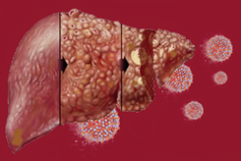
TRAINING OF CORE TRAINERS
CPG Management of Chronic Hepatitis C in Adults
INVESTIGATION
Dr. Salmah Idris
Consultant Medical Microbiologist

Slide 2
Learning Objectives
How to diagnose HCV infection
What type of test to screen HCV infection.
What is the confirmation test for HCV infection and the indication.
The role of HCV genotyping.

Slide 3
Investigations
Laboratory Test:
Diagnosis of HCV infection is based on two categories of laboratory tests:
serological assays - antibody (anti-HCV) & antigen (HCV core antigen/ HCVcAg)
molecular assays - detect & quantify HCV ribonucleic acid (RNA)
Play important role in the diagnosis of infection, therapeutic decision-making & assessment of virological response to therapy.

Slide 4
Antibody screening
Screening
Screening for hepatitis C infection (to determine serological evidence of past or present infection) in adults, adolescents & children (>18 months of age) is initiated by detection of a single test for anti-HCV antibodies using either:
rapid diagnostic test (RDT) or
laboratory-based immunoassay formats

Slide 5
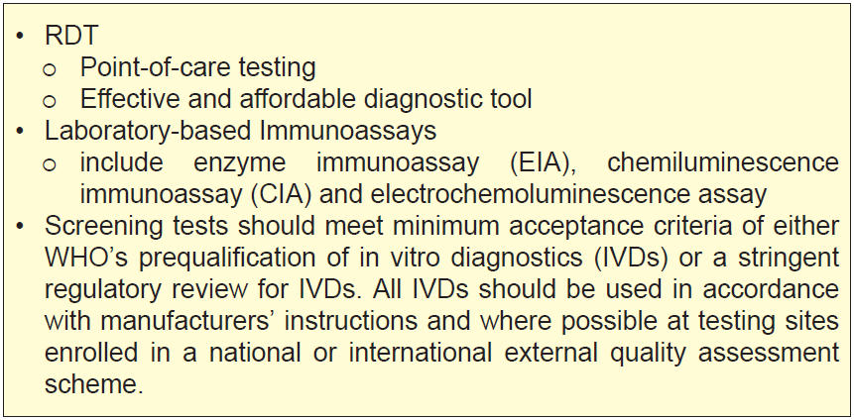
Screening -₂

Slide 6
CPG Recommendation

Slide 7
HCV Core Antigen (HCVcAG)
Confirmatory Test
In acute hepatitis C, HCVcAg (a viral protein) is found in the blood two weeks after infection. It becomes detectable in blood a few days after HCV RNA.
Uses enzyme-linked immunosorbent assay, is a lower-cost option than molecular test. However, it is less sensitive than HCV RNA assay (lower limit of detection equivalent to approximately 500 to 3,000 HCV RNA IU/mL).¹⁴
European Association for the Study of the Liver. J Hepatol. 2018;69(2):461-511.

Slide 8
HCV Core Antigen (HCVcAG)
Confirmatory Test -₂
Using a threshold of quantifiable HCV RNA (≥15 IU/mL), HCVcAg demonstrates consistently high specificity (98 - 100%) at all time-points but a wide range of sensitivity (31 - 100%). Among baseline samples, there is a strong correlation between HCVcAg levels & HCV RNA levels (r_{s} 0.767 - 0.89, p ≤0.0001).^{15, 16}
WHO has suggested that HCVcAg is too limited to recommend for its use as a substitute for HCV RNA as assessment of test of cure, known as SVR.¹⁷ However, EASL allows this as an alternative if the latter is not available and/or not affordable to be done at SVR 24.¹⁴
Lamoury FMJ et al. J Clin Virol. 2017;92:32-8.
Loggi E et al. PLoS One. 2017;12(11):e0187755.
World Health Organization. J Hepatol. 2018;69(2):461-511.

Slide 9
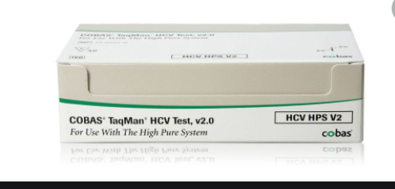
HCV molecular
Confirmatory Test -₃
Detect the presence of the virus, determine if the infection is active & if the individual would benefit from antiviral treatment.
The new generation of quantitative & qualitative assays have the same lower detection limit (around 15 IU/mL).

Slide 10
HCV molecular
Confirmatory Test -₄
Quantitative assays are a reproducible method to detect & quantify HCV RNA in plasma or serum.
The “gold standard” assays for the diagnosis & monitoring of HCV, the high cost of these assays & laboratory requirements means that they are not readily available in resource-limited settings.¹⁷

Slide 11
Confirmatory Test -₅

Slide 12
Confirmatory Test -₆

Slide 13
HCV genotype
Confirmatory Test -₇
HCV strains are classified into six major genotypes & 67 subtypes.
Determined by sequencing of genomic nucleotide sequence or by kit-based assays which employ complementary probes to report genotype present in a specimen.
Sequencing of highly conserved regions such as NS5, core, E1 & 5’UTR.

Slide 14
HCV genotype
Confirmatory Test -₈
The limit of detection of HCV genotype is 500 - 1000 IU/mL (depends on the type of reagents used) to get an accurate HCV genotype result.
Indication: Liver Cirrhosis & treatment failure
Testing for HCV resistance prior to treatment is not recommended.¹⁴

Slide 15
Confirmatory Test -₉

Slide 16
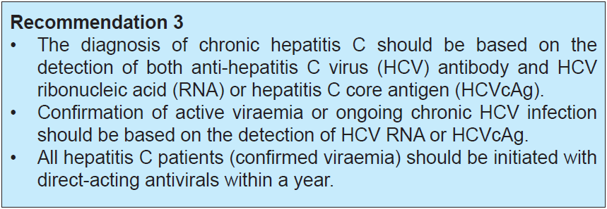
CPG Recommendation

Slide 17
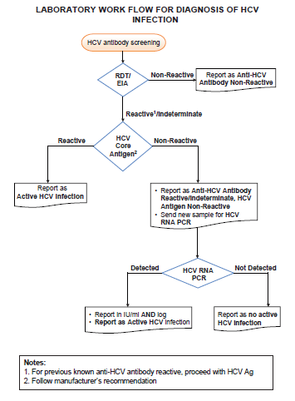
LABORATORY
WORK FLOW FOR DIAGNOSIS OF HCV INFECTION

Slide 18
Take Home Messages
The diagnosis of HCV infection is based on HCV antibodies.
The confirmation test is used after HCV antibody is positive.
HCVcAg & molecular detect the presence of the virus, determine if the infection is active & if the individual would benefit from antiviral treatment.
WHO has suggested HCV RNA as assessment of test of cure (SVR) but HCVcAg is too limited to recommend for its use.
However, EASL allows HCVcAg as a substitute if HCV RNA is not available and/or not affordable to be done at SVR 24.

Slide 19
Thank you

