Slide 1
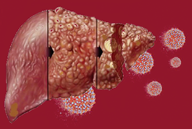
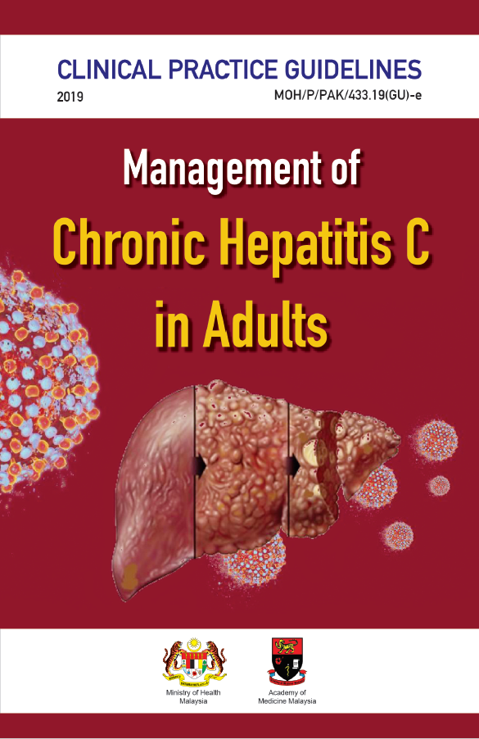
TRAINING OF CORE TRAINERS
CPG Management of Chronic Hepatitis C in Adults
PRE-TREATMENT ASSESMENT
Dr. Norasiah Abu Bakar
Gastroenterologist/Hepatologist

Slide 2
Learning Objectives
To identify co-morbidities & assess status of the liver of the patient
To assess the severity of liver fibrosis
To determine blood investigations need to be sent prior to the treatment
To know the non-invasive method of assessing liver fibrosis

Slide 3
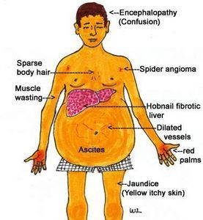
Pre-treatment Assessment
Prior to initiation of treatment, hepatitis C patients must be assessed to identify presence of co-morbidity & to determine cirrhosis status.

Slide 4
Blood Investigations
The following investigations need to be performed prior to the treatment:
full blood count
liver function test (LFT) including AST
serum creatinine
international normalised ratio (for all cirrhotic patients)
HIV & hepatitis B surface antigen screening
APRI and/or FIB-4 score

Slide 5
Non-invasive Methods
Accurate assessment on the severity of liver fibrosis is important for prognosticate and treatment planning in HCV patients.
Non-invasive methods of assessing fibrosis have been developed to reduce the need for liver biopsy.

Slide 6
Non-invasive Methods -₂
A systematic review evaluates the ability of non-invasive measures in assessing hepatic inflammation & fibrosis among chronic HCV patients.²¹
AST to platelet ratio index (APRI) is simple to be used in estimating fibrosis with AUC with a range of 0.87 - 0.89.
Smith JO et al. Aliment Pharmacol Ther. 2009;30(6):557-76.

Slide 7
Non-invasive Methods -₃
For Fibrosis-4 (FIB-4) index, the AUC was 0.765 for differentiating Ishak 0 - 3 from 4 - 6. This was validated in a large cohort study which demonstrated AUC of 0.85 for severe fibrosis & 0.91 for cirrhosis.
Transient elastography (TE) distinguished mild/moderate fibrosis from severe fibrosis/cirrhosis with AUC of 0.94.

Slide 8
Non-invasive Methods -₄
TE has better sensitivity & specificity compared with conventional USG or doppler USG. The AUC increases from stage F1 to F4 liver fibrosis for both TE & US. However, the results are higher in TE.²⁴ The diagnostic accuracy is much better in TE compared with doppler USG in F2 to F4 liver fibrosis. The AUC for TE in F2, F3 & F4 is 0.89, 0.96 & 1.0 respectively.²⁵
TE is available in limited centers whereas MRE is not available in Malaysia. However, once MRE is available, it can be incorporated into the MRI examination.
Wang JH et al. J Gastroenterol. 2009;44(5):439-46.
Moustafa EF et al. Arab J Gastroenterol. 2017;18(1):6-12.

Slide 9
CPG Recommendation
9

Slide 10
Evaluation of APRI, FIB-4 & TE
Note: The values mentioned in Table 1 are based on consensus of both CPG DG & RC.
Source:
World Health Organization. Geneva: WHO; 2018.
Castéra L et al. J Hepatol. 2009;50(1):59-68
10

Slide 11
Formula

Slide 12
Take Home Message
Differentiating non-cirrhotic & cirrhotic liver in pre-treatment assessment is important in determining the DAA regime.

Slide 13
Thank you

