Slide 1
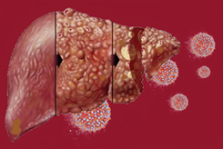
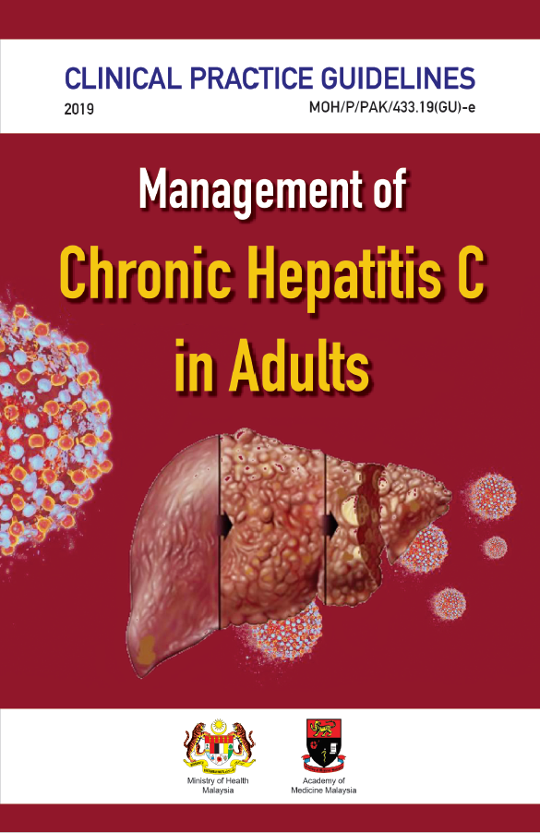
TRAINING OF CORE TRAINERS
CPG Management of Chronic Hepatitis C in Adults
TREATMENT
Dr. Haniza Omar
Gastroenterologist/Hepatologist

Slide 2
Learning Objectives
Assessing pre treatment assessment
Determining compensated & decompensated cirrhosis
Looking for drug-drug interaction (DDI) prior to initiating treatment with direct acting antiviral
Availability of types of direct acting antiviral (DAA)
Duration of treatment in different combinations of antiviral for different genotypes in treatment naïve & experience.

Slide 3
Goals of HCV Treatment
Primary Goal
Secondary Goal
Slow disease progression
Prevent complications from HCV infection
Eradicate HCV infection by achieving “Virologic Cure” (SVR)
Improve histology
Reduce risk of HCC
Improve health-related QOL
The goal of treatment: reduce all-cause mortality & liver-related health adverse consequences, including end-stage liver disease & hepatocellular carcinoma, by the achievement of virologic cure as evidenced by an SVR
Source:
Ghany MG et al. Hepatol 2009;49 (4):1335-74.
Lindsay K et al. Hepatol 2002;36 (5, Suppl 1):S114-20.

Slide 4
Non-pharmacological Treatment
HCV-infected patients should be counselled on the importance of strict adherence to attain high sustained virological response (SVR).
It is a multidisciplinary approach involving dedicated clinicians, pharmacists & nurses; it includes:
HCV education
monitoring services
peer-based support

Slide 5
The following group will need additional support during DAA treatment
Non-pharmacological Treatment -₂
European Association for the Study of the Liver. J Hepatol. 2018;69(2):461-511.
Dieperink E et al. Addiction. 2014;109(11):1869-77

Slide 7
Pre-treatment Assessment
Prior to initiation of treatment, hepatitis C must be assessed to identify presence of co morbidity and to determine cirrhosis status.
The following investigations need to be performed:
full blood count (FBC)
liver function test (LFT)
serum creatinine
international normalisation ration (INR)
HIV & HBsAg screening

Slide 8
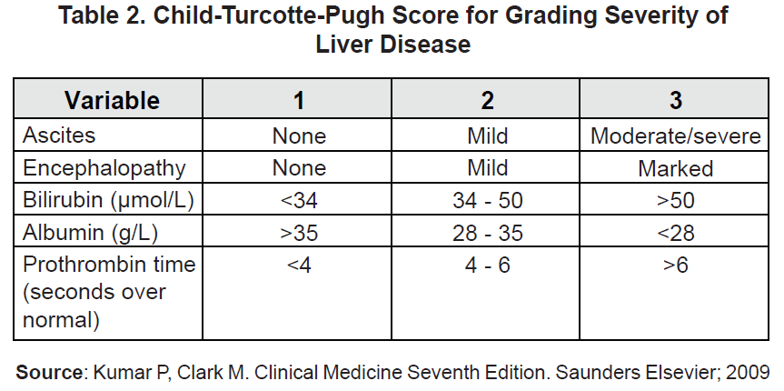
Pre-treatment Assessment -₂
For those with cirrhosis, assessment for compensated & decompensated cirrhosis using CPS score .

Slide 9
Pre-treatment Assessment -₃

Slide 10
Drug-drug Interactions (DDIs)
Pre-treatment assessment of concomitant medication should be done to avoid DDI
Prescribers may consult the University of Liverpool webpage on hepatitis drug interactions at https://www.hep-druginteractions.org/checker

Slide 11
Direct-acting antivirals (DAAs)
Treatment for chronic hepatitis C has evolved from using pegylated-interferon (PEG-IFN) with low cure rates and many side effects to various regimes of oral DAAs.
The aim is to provide high cure rate or SVR by using drugs that are effective with short duration treatment and minimal side effects.

Slide 12
Direct-acting antivirals (DAAs) -₂
Hepatitis C patients (confirmed viraemia) should be considered for DAA treatment except in those with limited life expectancy or significant non-liver-related co-morbidities.
Treatment should be initiated without delay in those with significant fibrosis or cirrhosis, including those with decompensated cirrhosis & clinically significant extra-hepatic manifestations due to HCV infection.¹⁴

Slide 13
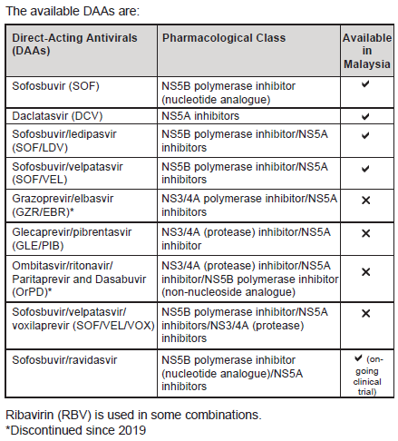
Direct-acting antivirals (DAAs) -₃

Slide 14
Sustained Virological Response (SVR)
The endpoint of therapy is an SVR, defined by undetectable HCV RNA in serum or plasma 12 weeks (SVR12) or 24 weeks (SVR24) after the end of therapy, as assessed by a sensitive molecular method with a lower limit of detection ≤15 IU/ml
Notes:
Long-term follow-up studies have shown that an SVR corresponds to a definitive cure of HCV infection in the vast majority of cases.
Undetectable HCV core antigen 24 weeks after the end of therapy can be used as an alternative to HCV RNA testing to define the SVR24, respectively, in patients with detectable core antigen before treatment.

Slide 15
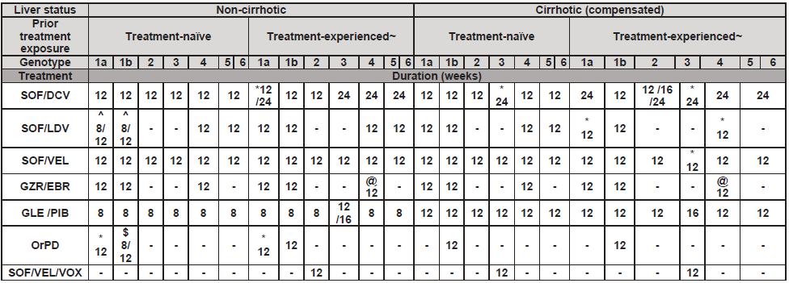
Pharmacological Treatment
Duration (weeks)

Slide 16
Pharmacological Treatment -₂
Duration (weeks)

Slide 17
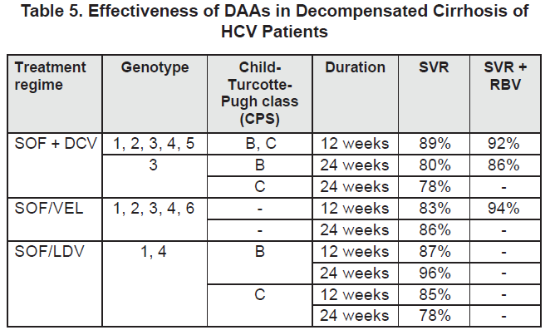
Pharmacological Treatment -₃
Decompensated Cirrhosis

Slide 18
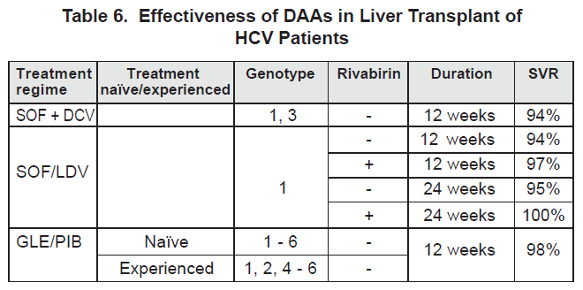
Pharmacological Treatment -₄
Liver Transplant Patients

Slide 19
Take Home Messages
Treating patients with Hepatitis C has been made simple with the availability of the new oral DAAs.
The aim of treatment is to achieve SVR.
DDI should be assessed to avoid potential side effects.
Duration of treatment are 12 weeks for non-cirrhotic & treatment-naïve group.
Duration of treatment are 12 - 24 weeks in the cirrhotic group depending on genotypes & if the patient has been on treatment before.

Slide 20
Thank you

