Slide 1
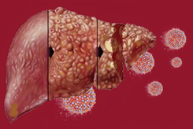
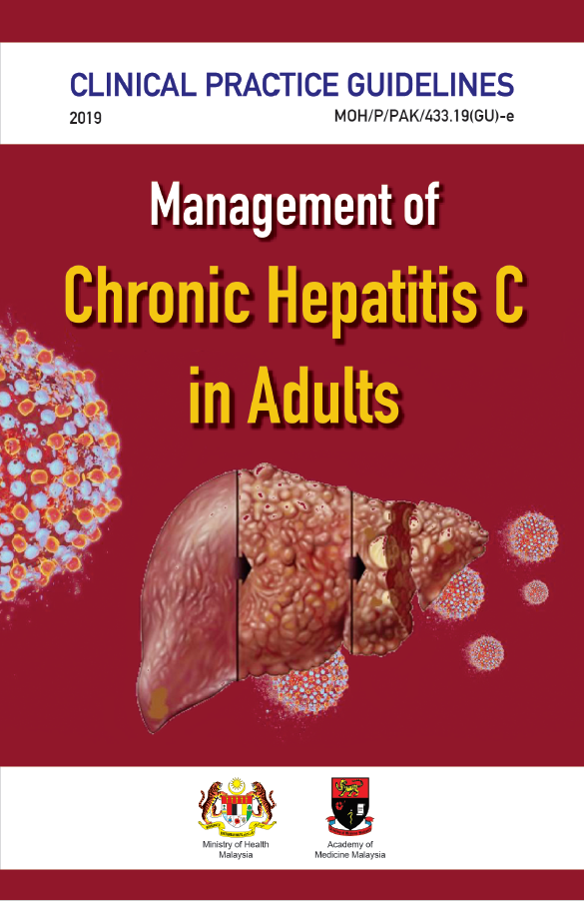
TRAINING OF CORE TRAINERS
CPG Management of Chronic Hepatitis C in Adults
HCV/HIV
CO-INFECTION
Dr. Ahmad Kashfi Ab Rahman
Consultant
Infectious Disease Physician

Slide 2
Learning Objectives
To learn on:
efficacy & safety of the direct-acting antivirals (DAAs) regime for HIV/HCV co-infected patients.
timing to start DAAs in HIV/HCV co-infection.
potential drug-drug interaction between DAAs & antiretroviral therapy (ART).

Slide 3
HIV Co-infection
HIV/HCV co-infected patients are at higher risk to develop liver-related morbidity & mortality than HCV mono-infected patients.
Having well-controlled HIV & restored immune function while on ART reduces the risk of liver disease progression due to hepatitis C.
Co-infection will likely accelerate liver disease progression, therefore early hepatitis C treatment is beneficial.
3

Slide 4
HIV Co-infection -₂
Fewer HIV/HCV co-infected patients have been treated in DAAs trials;
Sofosbuvir + Daclatasvir (SOF+DCV)
The combination of SOF+DCV once daily for 12 weeks achieved SVR12 between 91% to 98% of treatment-naïve and treatment-experienced HIV/HCV.⁴⁸
Wyles DL et al. N Engl J Med. 2015;373(8):714-25.
4

Slide 5
HIV Co-infection -₃
Sofosbuvir/Ledipasvir (SOF/LDV)
Studies had shown that SOF/LDV for 12 weeks were associated with high SVR12 rates of 96 - 100% in HIV/HCV co-infections.⁴⁹ ⁻ ⁵⁰
Sofosbuvir/Velpatasvir (SOF/VEL)
SOF/VEL for 12 weeks is safe & achieves overall SVR12 of 95% including in compensated cirrhosis & treatment-experienced HIV/HCV co-infections.⁵⁵
Milazzo L et al. HIV Med. 2017;18(4):284-91.
Hawkins C et al. J Antimicrob Chemother. 2016;71(9):2642-5.
Wyles D et al. Clin Infect Dis. 2017;65(1):6-12.
5

Slide 6
DAAs Efficacy in HCV/HIV Co-infected Person
The effectiveness among this group has been remarkably similar to the HCV mono-infected group in the evidence discussed earlier.
6

Slide 7
CPG Recommendation
7

Slide 8
When to start DAAs?
People with HIV/HCV co-infection are advised to start ART soon after being diagnosed with HIV (WHO 2016).
This is especially so if CD4 cell count is below 350 cells/µL; to improve immune function.
Treatment of these patients requires special attention due to the complexity of drug-drug interactions (DDI) that can occur between DAAs & antiretroviral medications.
HIV treatment should not be interrupted in order to start hepatitis C treatment.
8

Slide 9
When to start DAAs? -₂
9

Slide 10
DDIs - NRTIs
SOF/DCV has no significant DDI with NRTIs.
SOF/LDV increases tenofovir levels when given as tenofovir disoproxil fumarate (TDF), which may increase the risk of tenofovir-associated renal toxicity.
SOF/VEL increases tenofovir levels when given as TDF, which may increase the risk of tenofovir-associated renal toxicity.
These combinations should be used with caution with close monitoring of renal profile in patients with an eGFR <60 ml/min/1.73 m².²⁸
10
AASLD-IDSA HCV Guidance Panel. Clin Infect Dis. 2018;67(10):1477-92.

Slide 11
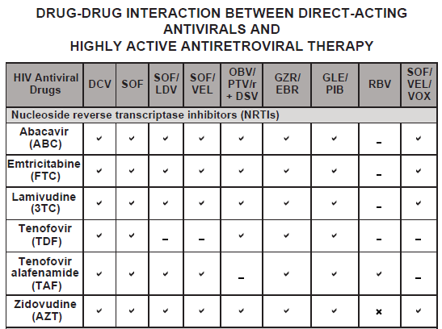
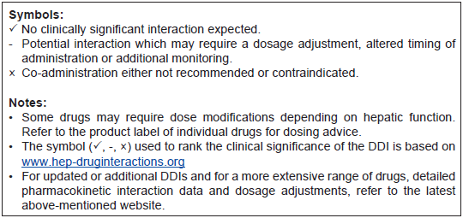
DDIs - NRTIs -₂
11

Slide 12
DDIs - NNRTIs
The dose of DCV should be increased from 60 mg to 90 mg when used with potent inducer of cytochrome P450 (CYP) 3A4 e.g. efavirenz (EFV), etravirine (ETV) or nevirapine (NVP).
LDV’s AUC decreases by 34% when co-administered with EFV-containing regimes.
Although no dose adjustments of LDV are recommended to account for these interactions, the combinations should be used with cautions & frequent renal monitoring.²⁸
SOF/VEL is not recommended to be used in patients on EFV, NVP or ETV.
12

Slide 13
DDIs - NNRTIs -₂
13

Slide 14
DDIs - Protease Inhibitors
DCV should be decreased from 60 mg to 30 mg when used with CYP 3A4 inhibitor e.g. ritonavir-boosted atazanavir, cobicistat-boosted atazanavir or elvitegravir/cobicistat.
The usual DCV dose should be used with ritonavir-boosted darunavir & ritonavir-boosted lopinavir.²⁸
LDV’s AUC increases by 96% when co-administered with ritonavir-boosted atazanavir.
Although no dose adjustments of LDV are recommended to account for these interactions, the combinations should be used with caution and frequent renal monitoring.²⁸
SOF/VEL combination can be safely used in lopinavir/ritonavir-containing regimen.
14

Slide 15
DDIs - Protease Inhibitors -₂
15

Slide 16
DDIs - Protease Inhibitors -₃
16
Source: John JF. A Quick Guide for Clinicians. April 2017.

Slide 17
DDIs - Integrase Inhibitors
All available DAAs in the market have no significant DDI with integrase inhibitor group of antiretroviral (ARV).
A standard dose of 60mg can be used.
17

Slide 18
DDIs - Integrase Inhibitors -₂
18

Slide 19
DCV Interactions with Commonly Used Medications Among HIV Patients
Medication and/or Class | Recommendation & Clinical Comment
Strong inhibitor of CYP3A
Antibiotics - clarithromycin | Decrease DCV dose to 30mg once daily
Antifungals - itraconazole, posaconazole, voriconazole
Moderate inducer of CYP3A
Antimycobacterial - rifapentine | Increase DCV dose to 90mg once daily
Corticosteroids - dexamethasone
Strong inducer of CYP3A
Antimycobacterial - rifampicin | Co-administration is not recommended
Other medications
Anticholesterol - atorvastatin, pravastatin, rosuvastatin | Monitor for HMG-CoA reductase toxicity
Opioid substitution therapy - methadone, buprenorphine | Monitor for OST toxicity
Source: John JF. A Quick Guide for Clinicians. April 2017.
19

Slide 20
Take Home Messages
DAAs is as effective & safe in HIV/HCV co-infected as in mono-infected people.
Treating underlying HIV before starting treatment of hepatitis C is preferable.
The dose for DCV will vary according to different class of ARV.
20

Slide 21
Thank you

