Slide 1
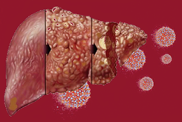
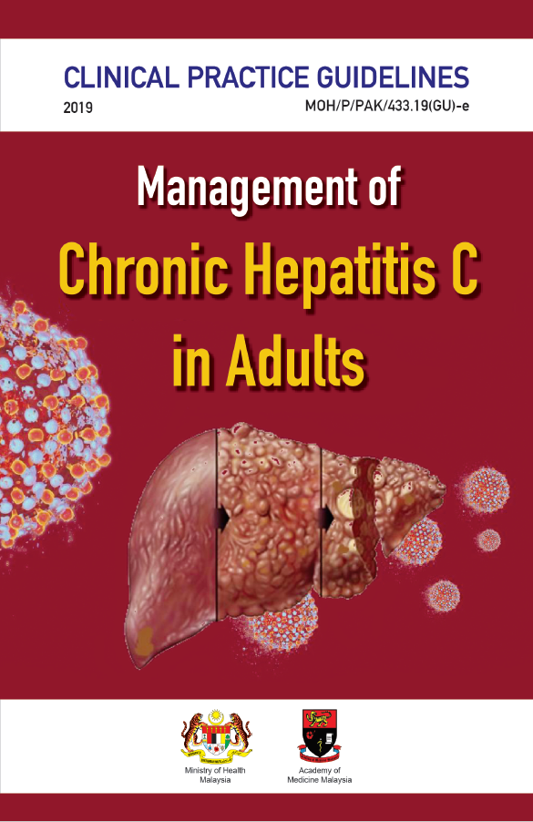
TRAINING OF CORE TRAINERS
CPG Management of Chronic Hepatitis C in Adults
MONITORING & FOLLOW-UP
Dr. Zalwani Zainuddin
Gastroenterologist/Hepatologist

Slide 2
Learning Objectives
To learn on:
monitoring of patients treated with DAAs
follow-up schedule once patient completed treatment
referral criteria for hepatitis C

Slide 3
Monitoring During DAAs
New DAA regimens are generally well tolerated.
Frequencies of high grade or severe adverse events leading to discontinuation are very low.
The American Association for the Study of Liver Diseases (AASLD) and the European Association for the Study of the Liver (EASL) recommend a monitoring schedule that includes baseline, week 4 & week 12 after the end of treatment.

Slide 4
Monitoring During DAAs -₂
Source: World Health Organization. Geneva: WHO; 2018.

Slide 5
Monitoring During DAAs -₃
Renal function should be checked monthly in patients with reduced eGFR receiving sofosbuvir (SOF).
Treatment must be stopped in case of severe adverse events or in case of a hepatitis flare (ALT levels >10 times normal, if not already present at the time of starting treatment).
In patients who need ribavirin (RBV), the dose of RBV should be adjusted downward by 200 mg in decrements if the haemoglobin (Hb) level drops <10 g/dL. RBV administration should be stopped if the Hb levels drops <8.5 g/dL

Slide 6
Monitoring During DAAs -₄
HIV & HBV co-infection with/without cirrhosis or renal impairment, presence of potential DDIs & ill-health may also necessitate more frequent monitoring.
6

Slide 7
Missed Dosing
Monitoring During DAAs -₅
7
Source: Dhiman RK et al. J Hepatol. 2019 Dec;71(6):1076-1085.

Slide 8
Monitoring During DAAs -₆
Missed Dosing
A treatment interruption was defined as treatment interruption for >7 days or treatment discontinuation.
If the interruption of treatment was for ≤7 days, treatment was continued for the remaining duration as prescribed & SVR12 was assessed 12 weeks after the completion of treatment.
If interruption of treatment was >7 days & the patient had taken treatment for <4 weeks, then the treatment was started afresh.
If interruption of treatment was >7 days & the patient had taken treatment for ≥4 weeks or more, then HCV RNA was measured after 12 weeks of cessation of drug to assess for SVR12.
8

Slide 9
Post-treatment Follow-up
NOT CIRRHOTIC
CIRRHOTIC
ACHIEVED SVR12
ACHIEVED SVR12
NO SVR12
Patients who achieve SVR12 can be discharged
Patient with persistent deranged LFT should be investigated for other causes of liver diseases
Need to be counsel regarding possibility of reinfection amongst high risk groups
Continue follow up for HCC surveillance: 6-monthly US liver & blood for AFP
Endoscopy for OV surveillance
Should monitor for progression of liver disease & considered for retreatment once alternative treatment is available.
9

Slide 10
When to Refer
When to Refer
cirrhosis
treatment failure
hepatitis B co-infection
CKD stage 4 & 5
extrahepatic manifestation
haemoglobinopathies
solid organ transplantation
Patient with compensated cirrhosis,
treatment-naïve should be able to be treated at Klinik Kesihatan or any physician base clinic.
10

Slide 11
Take Home Messages
New DAA regimen are well tolerated & safe.
Follow-up & monitoring is recommended at week 4 of treatment & week 12 post treatment.
More frequent follow-up should be tailored to patient's characteristic such as cirrhosis, regimen containing ribavirin, renal impairment, HIV/HBV co-infection, multiple comorbidities.
Non-cirrhotic patients without other liver diseases who has achieved SVR12 can be discharged from follow-up.
Cirrhotic patients who achieved SVR12 will need surveillance for HCC.
11

Slide 12
Thank you

