Slide 1



TOT PROSTAR 2.0
9 OGOS 2023 8.00 Pagi – 5.00 Petang Bilik Seminar Ixora Hospital Permai

Slide 2
Tentatif

Slide 3
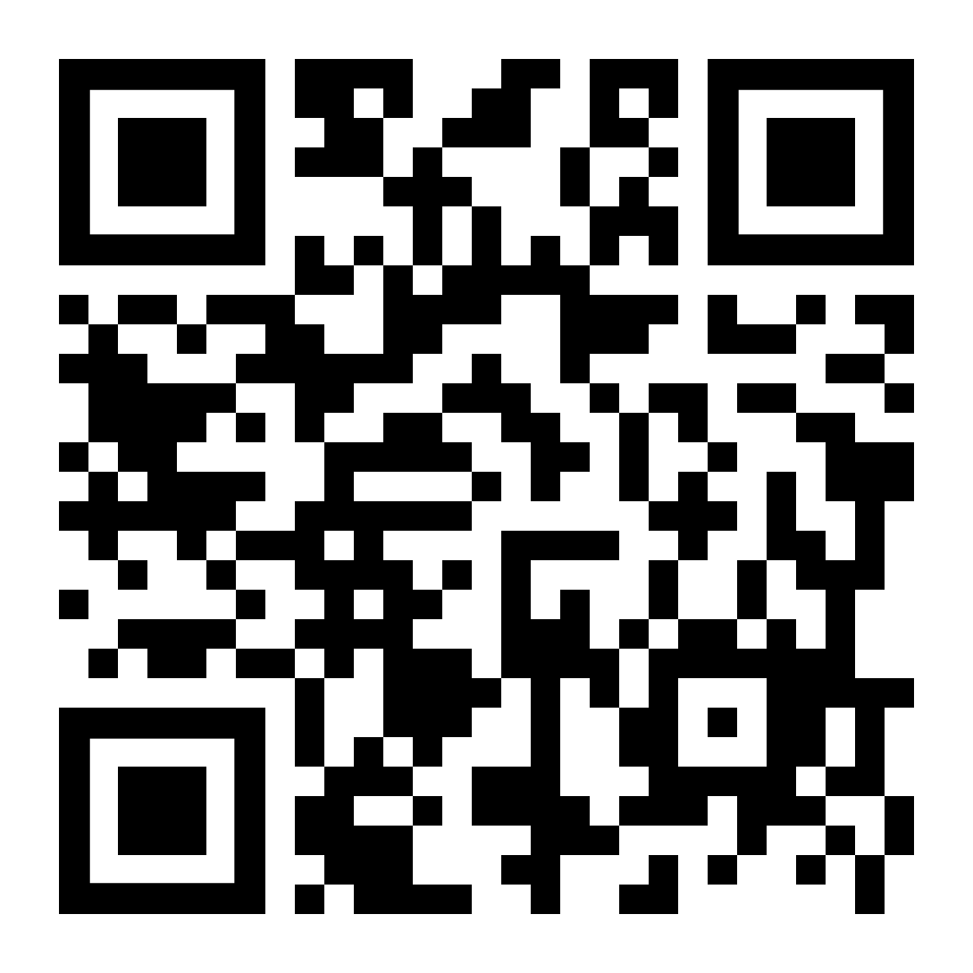
Pre Test

Slide 4
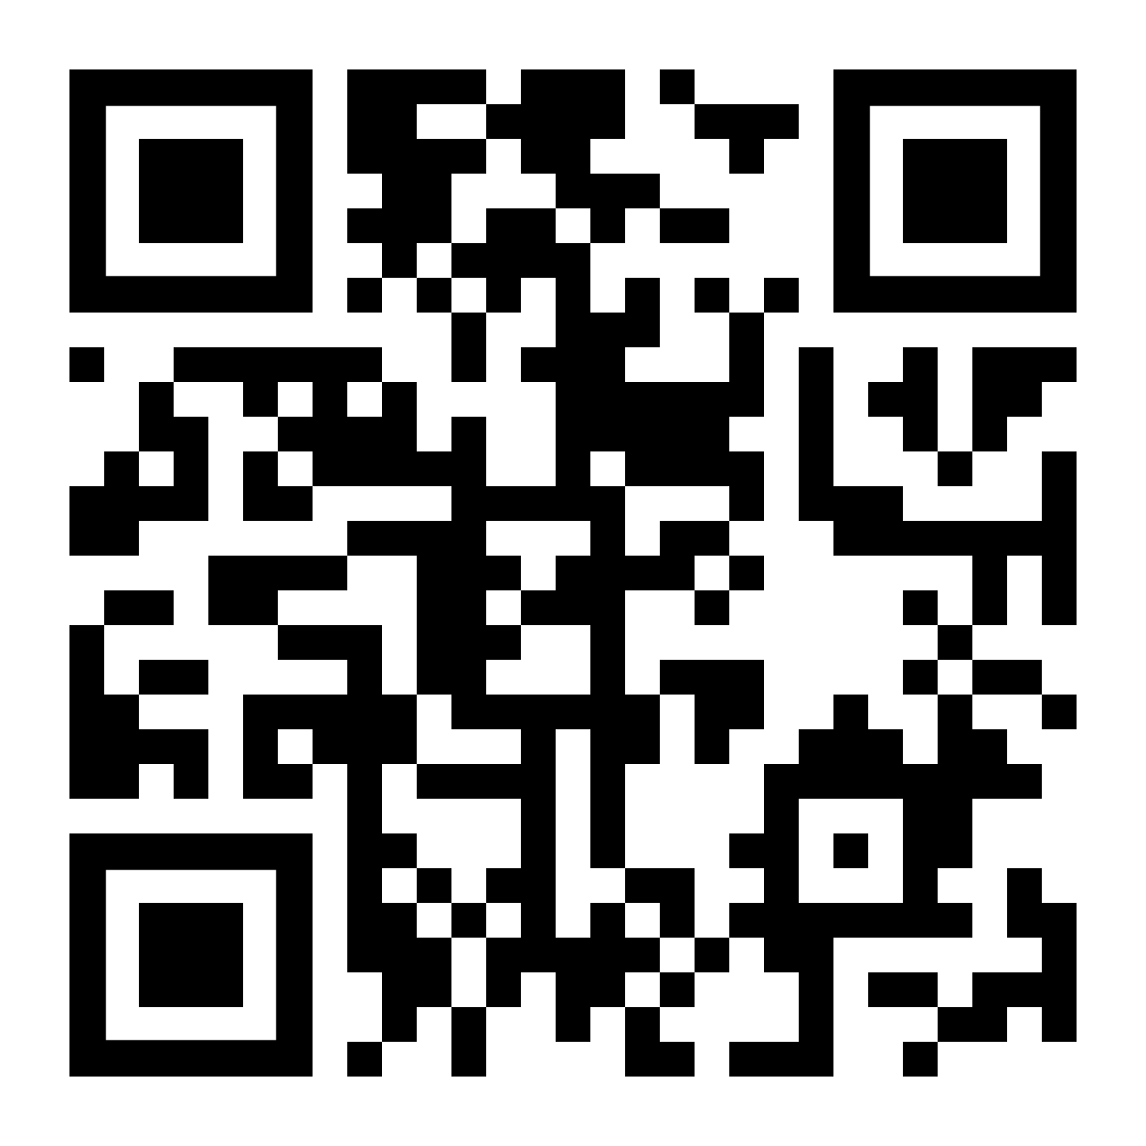
Post Test

Slide 5
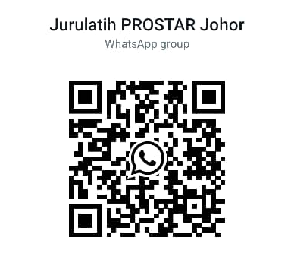
QR Code Group Whatsapp

Slide 6
QR Gambar Program

